Slide 1

Smart Identity Management Platform Layout
Brittany Jacques
Debolina Mukherjee
Glenn Kees
Jaime Barragan

Slide 2

Hypothesis
The identity of an individual using well-know or verifiable evidence is key for recognition. In today’s world, the most efficient way of storing and accessing this information is in digital form. This project hypothesizes that using “Smart Identity” documents powered by blockchain we can create a universal and secure platform for users to manage and exchange this verifiable evidence.

Slide 3

Motivation & Goal
Motivation behind this project was to establish a safe and dependable way to keep sensitive information stored on a blockchain. This was achieved by creating a smart contract that can store/change/remove any information that as deemed fit to build or a digital identity

Slide 4
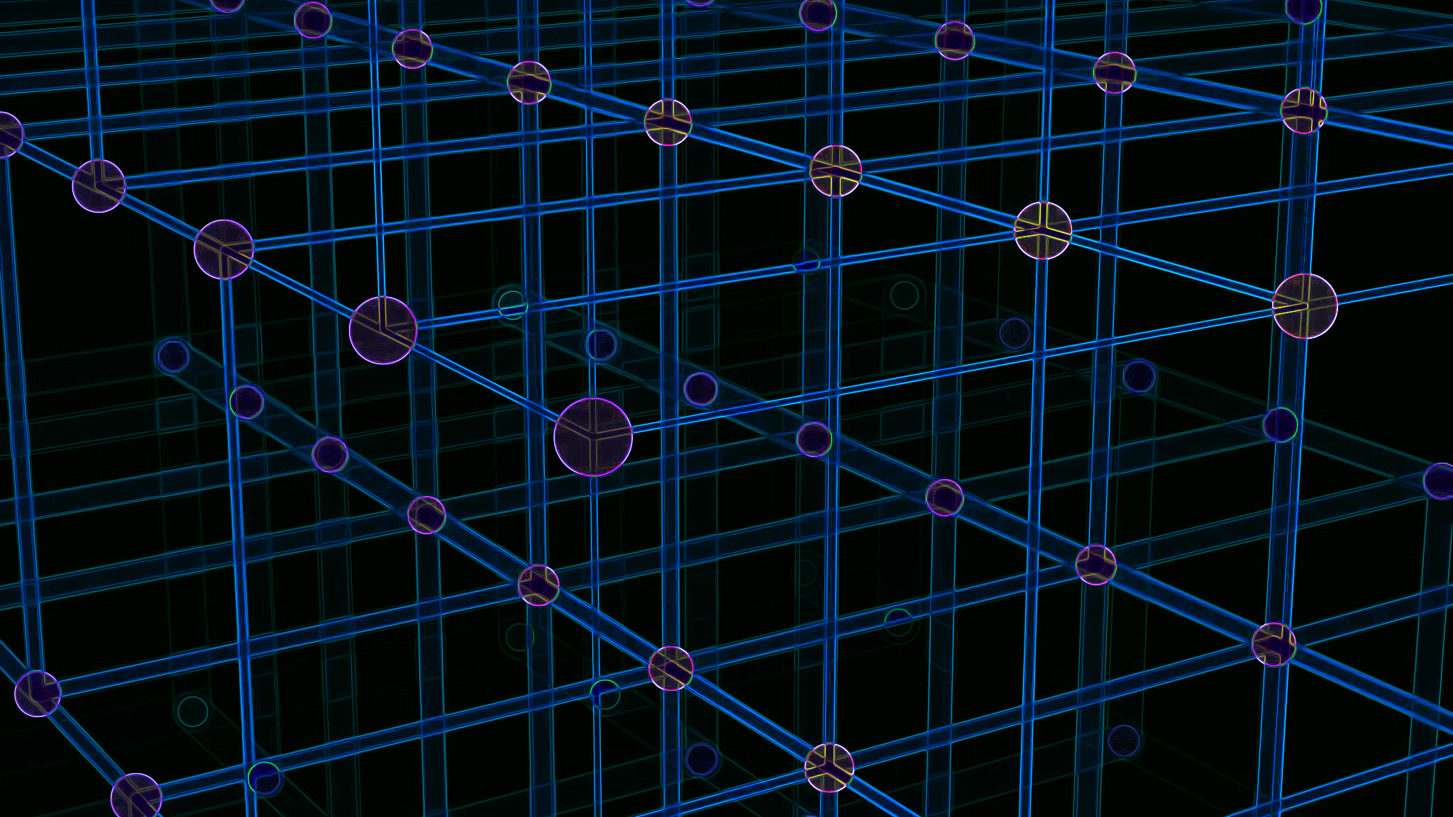
Summary
Front-end Web UI developed using Streamlit
ERC721 (NFT) Smart Contract implemented using Solidity
Web3 integration with Python for communication with Blockchain
Pinata for convenient integration of document media with IPFS

Slide 5

Data Exploration & Clean up

Slide 6

Results & Conclusions

Slide 7
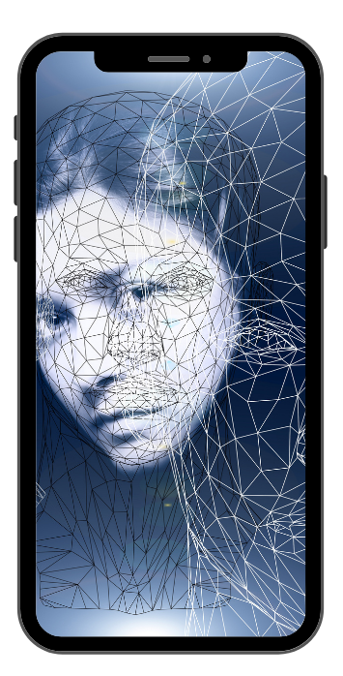

DEMO
Notes:
Glenn
<number>

Slide 8
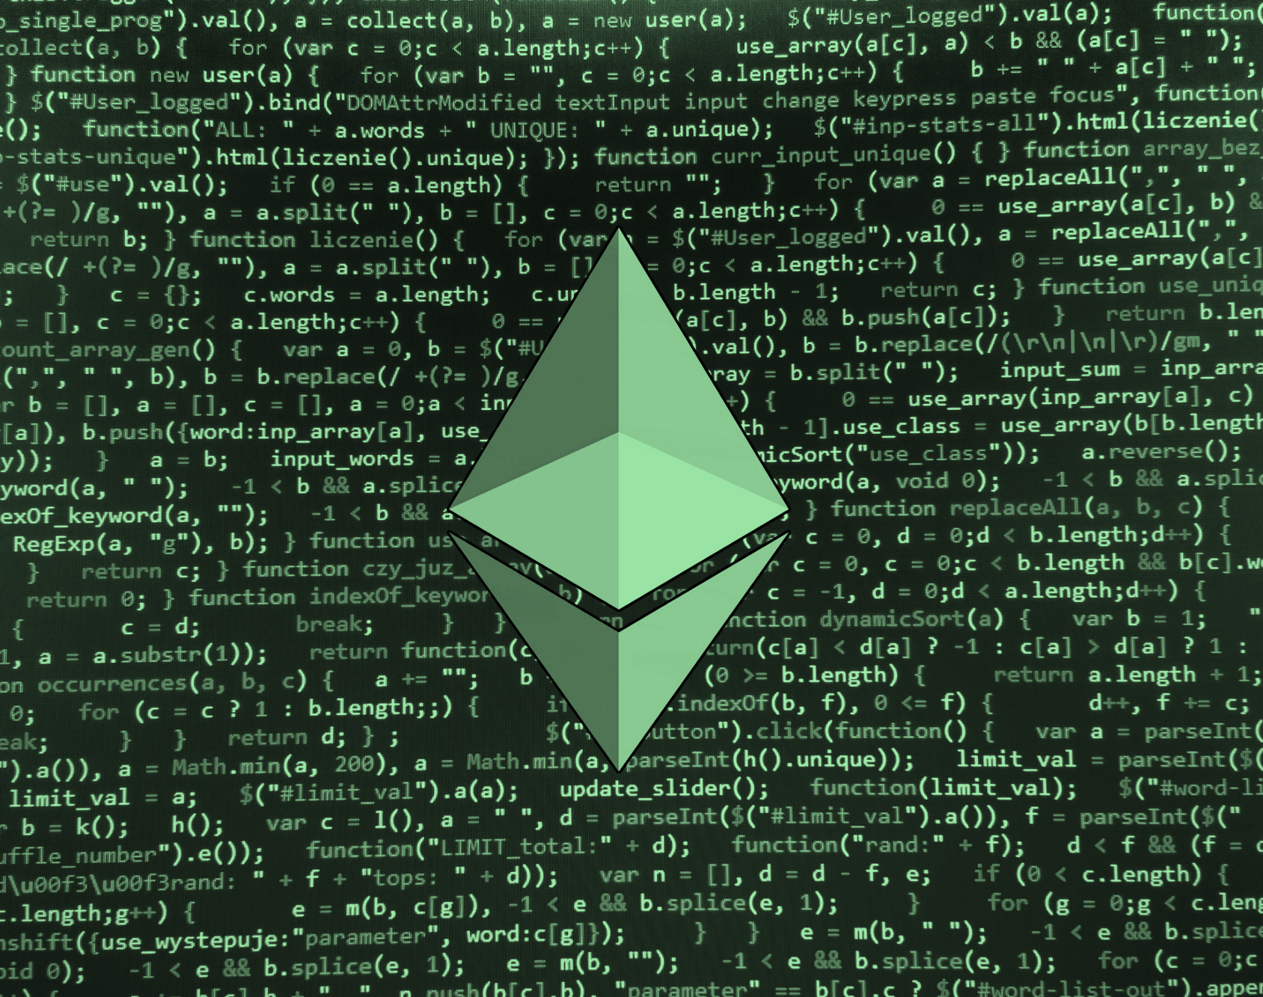
Next Steps
Authentication layer
ID Verification for ID scanning
Encryption
Payment gateway

Slide 9

Questions

